Slide 1
Entrepreneurship Business Communication II
Salmaan Rahman
Fall 2020
Lecture 4 – Proposals and Reports
Guffey Chapters 9 & 10

Slide 2
Question:
What is the difference between a feasibility study and a business plan?

Slide 3
Answer:
Feasibility studies determine whether to go ahead with the business or with another idea.
Business plans are designed after the decision to go ahead has already been made.
Essentially, feasibility studies are research projects, whereas business plans are projections for the future.
Feasibility studies are submitted as (analytical) reports
Business plans can be either a report, or a proposal or a hybrid, depending on the audience

Slide 4
Reports:
Reports are a routine standard of business communication in the corporate world
Vertical communication – upwards and downwards in hierarchy
Horizontal communication – between departments
Outside interests – stakeholders, Govt. etc.

Slide 5
Reports:
Reports are generated whenever results need to communicated
End of year reports
Project updates (work in progress) and results
Summation of events (meetings, projects, analysis, business trips, etc)
Reports may be
informal or formal
Oral or written: email, letter, memo, full document

Slide 6
Reports: Function
Reports fit into two broad categories:
Informational reports
Present data without analysis or recommendations
Trip reports
Meeting minutes
Status reports
Routine operational reports
Regulation compliance
Policy, procedural reports
Analytical reports
Provide data, findings, analysis, recommendations, conclusions
Feasibility reports, investment reports, etc
Need to be persuasive
Provide supporting information, pros, cons,

Slide 7
Reports and Strategy
Like any other communication, reports also need a well thought out strategy to accomplish goals (objectives)
Direct: purpose of report given first
Informational reports
Analytical reports where readers are already supportive of idea
Indirect
Analytical reports where some persuasion is needed
Where information and supporting data is needed to inform or educate (uninformed audience, hostile audience)
When conclusions and recommendations are included
Problem -> facts and alternatives -> solutions

Slide 8
Report Formats
Format depends on several factors:
Length
Topic
Audience
Purpose
Typical formats:
Letter
Memo / email
Manuscript
Preprinted forms
Digital

Slide 9
Report Formats:
Letter
Short, (8 pages or less)
Used for outside audience (customers, stakeholders etc)
Usually informal, but must include date, address, salutation, close, etc
Usually include heading and subheadings
Information needs to be well organized, flow logically, and in business language

Slide 10
Report Formats:
Memo and e-mail reports
Short, informal reports
Used only for within the organization
Memo reports begin with standard headings
Date, To, From, Subject
Usually attached with covering email if long, or within email
Rarely given in hardcopy
Preprinted forms
Usually used for repetitive, or routine data
Monthly sales, performance appraisals, inventories, personell or financial reports
Standardized according to needs

Slide 11
Report Formats:
Manuscript reports:
Longer, more formal reports
Usually hardcopy, on plain paper instead of letterhead
Requires proper title, headings, and subheadings
Digital format
PDF reports
Decks
Electronic presentations
Usually distributed through email, electronics bulletin boards, wikis, or on the web
Allows for hyper-linking to other sites and information sources

Slide 12
Reports – Writing process
Problem and purpose
Statement of purpose
Analysis, persuasion, solution, report on projects?
The statement of purpose is often used as an introductory statement
“This report recommends a plan to provide sales representatives with transportation during outstation trips”
Identify audience and decide on strategy
Primary and secondary audience

Slide 13
Reports – Writing process
Gather information from secondary and primary sources
Secondary sources
Company records
Printed material
Electronic sources
Primary sources
Observation
Surveys, questionnaires, inventories
Interviews

Slide 14
Informal Reports - Categories
6 Categories
Informational reports
Progress reports
Justification/recommendation reports
Feasibility reports
Minutes of meeting
Summaries

Slide 15
Informal Reports – Informational Reports
Informational reports provide information without conclusions or recommendations
Procedural reports, police reports, financial reports
Typically:
Explain why the report is being written in introduction
Describe methods and sources of information collection
Provide background information if necessary
Organize the facts and findings into a logical sequence (chronological, alphabetical, geographical, journalistic, sequential)
Summarize findings, suggest any actions to be taken if needed, express appreciation at conclusion

Slide 16
Informal Reports – Progress Reports
Usually used to update stakeholders (external or internal) on progress of continuing operations and projects
Specify in opening the purpose and nature of project
Provide background information if necessary
Describe work completed
Explain work currently in progress
Describe current problems and expected problems and possible remedies
Discuss future activities, timeline till completion

Slide 17
Informal Reports – Justification/Recommendation Reports
Reports written to justify or recommend something - new equipment purchase, change in procedure or policy, hiring decision, changes in operations
Direct Strategy:
Identify problem, situation, need, in introduction
Announce the recommendation, solution or action
Explain the benefits of the recommendation or steps to solution
Discuss pros, cons, and costs
Conclude with summary specifying the recommendation and necessary actions.

Slide 18
Informal Reports – Justification/Recommendation Reports
Indirect Strategy. Used when reader may oppose a recommendation or when circumstances suggest
Refer to the problem in general terms, not to your recommendation, in the subject line
Describe the problem or need using specific examples, supporting statistics, and authoritative quotes to lend credibility to the seriousness of the problem
Discuss alternative solutions, beginning with the least likely to succeed.
Present most promising alternative (your recommendation) last.
Show how the advantages of your recommendation outweigh its disadvantages.
Summarize your recommendation. If appropriate, specify the action it requires.
Ask for authorization to proceed, if necessary.

Slide 19
Informal Reports – Feasibility reports
Feasibility reports examine the practicality and advisability of following a course of action.
They answer this question: Will this plan or proposal work?
Typically internal reports written to advise on matters
consolidating departments, offering a wellness program to employees, or hiring an outside firm to handle a company’s accounting or computing operations. New Business.
Usually prepared internally, but may also be prepared by outside consultants hired to investigate a problem

Slide 20
Informal Reports – Feasibility reports
Generally, feasibility reports are not designed to persuade the reader to accept decisions, but to present findings and decisions
Announce decision immediately.
Describe the background and problem necessitating the proposal.
Discuss the benefits of the proposal.
Describe problems that may result and solutions
Calculate costs associated with the proposal, if appropriate
Show time frame necessary for implementing the proposal

Slide 21
Informal Reports – Minutes of Meetings
Minutes summarize the proceedings of meetings.
Formal, traditional minutes, are written for large groups and legislative bodies, and for internal record keeping
Provide the name of the group, as well as date, time, and place of meeting
Identify the names of attendees and absentees
State whether the previous minutes were approved or revised
Record old business, new business, announcements, and reports
Include the precise wording of motions; record any vote and action taken.
Conclude with the name and signature of the person recording the minutes.

Slide 22
Informal Reports Summaries
A summary compresses the main points from a book, report, article, Web site, meeting, or convention.
Summaries are done to save time by reducing an article by 85 to 90 percent
Summaries condense technical reports, periodical articles, or books so that staff or superiors grasp the main ideas quickly
Present the goal or purpose of the document being summarized. Why was it written?
Highlight the research methods (if appropriate), findings, conclusions, and recommendations
Omit illustrations, examples, and references
Organize the readability by including headings and bulleted or enumerated lists
Paraphrase from the article. Do not copy passages
Include your reactions, opinions or evaluation of the document ONLY if asked to do so.

Slide 23
Formal Business reports
Formal business reports are similar to formal proposals in length, organization and tone
Represent the end product of investigation and analysis.
Present ordered information to decision makers
Business leaders, industry, government, education
Key to providing the data needed to make decisions

Slide 24
Formal Business reports Process
Preparing to write
Researching secondary data
Generating primary data
Documenting data
Organizing and outlining data
Illustrating data
Presenting final report

Slide 25
Formal Business reports Preparing to write
Preparing to write:
Definition of the project
Most important to identify the scope of the report
Identify limitations, constraints
Timeline
Accessibility of information/data sources
Write a statement of purpose
Identify the goals, significance, and limitations
Use action verbs – analyze, choose, investigate, compare, justify, evaluate etc.
“The purpose of this report is to explore. . . .”
“This report will evaluate and compare two….”
“This research will address the following hypothesis….”

Slide 26
Formal Business reports Researching Secondary Data
Secondary data: secondary data is collecting information that others have experienced, observed or written down (published)
Print sources – books, periodicals, bibliographic indexes
Electronic Databases
ABI/INFORM Complete (ProQuest)
Factiva (Dow Jones)
LexisNexis Academic
Academic Search Premier (EBSCO)
The Web
Risk of inaccurate or misleading information
Ensure proper accreditation, track citations
Blogs and Social networks

Slide 27
Formal Business reports Generating Primary Data
Generating Primary data: since most business reports are required for very specific and current problems, primary data is usually essential
Surveys/ questionnaires – collect data from groups of people
Online
In-person
Email, letter etc.
Interviews – of experts, target audience, etc.
Observation and experimentation
Firsthand observation
Time/motion studies

Slide 28
Formal Business reports Documenting Information
Documenting gathered information: Since research builds on ideas and words of others, credit has to be given to the original
Plagiarism – using the ideas/words of someone else without giving credit
Credit must be given even when you paraphrase
Accreditation strengthens arguments, instructs readers about sources, and protects against plagiarism
Credit must be given whenever
You use another person’s ideas, opinions, examples or theory
Any facts, statistics, graphs, and drawings
Quotations of spoken or written words
Paraphrases of spoken or written words

Slide 29
Formal Business Reports Documenting information (cont.)
Books: record title, author, publisher, place of publication, and pages cited
Newspaper, periodical: publication title, article title, author, issue/volume number, date, and pages cited
Website: record name of company, organization, and URL
***** Remember: accreditation must be given for both exact citations and paraphrases!****

Slide 30
Formal Business Reports Documenting information (cont.)
Using exact quotes:
To provide objective background data
To repeat identical phrasing
To duplicate exact wording before criticizing
Do not overuse! Summarize or paraphrase in most cases.
Use quotation marks and introductory phrase:
According to Walker, the effect of pre-quotes on sales. .
Walker writes: “The effect of pre-quotes on sales is..”

Slide 31
Formal Business Reports Organizing and Outlining Data
Organizational Strategies:
Where to place Findings, Conclusions, and Recommendations
How to organize findings
Most formal reports tend to be persuasive, so an indirect approach works best
Data is presented first, and conclusions last
A direct approach may be used where reader is already informed, or supportive

Slide 32
Formal Business Reports Organizing and Outlining Data (cont)
Outlines and Headings
Outlines are not included in the final report, but help organize information and divide it into useful segments and subpoints
The main points of the outline usually become the main headings of the written report
Major headings (Titles, etc) are centered in bold font
Subheadings (second-level headings) are left justified
Third level headings are indented (line drop) and part of the paragraph

Slide 33
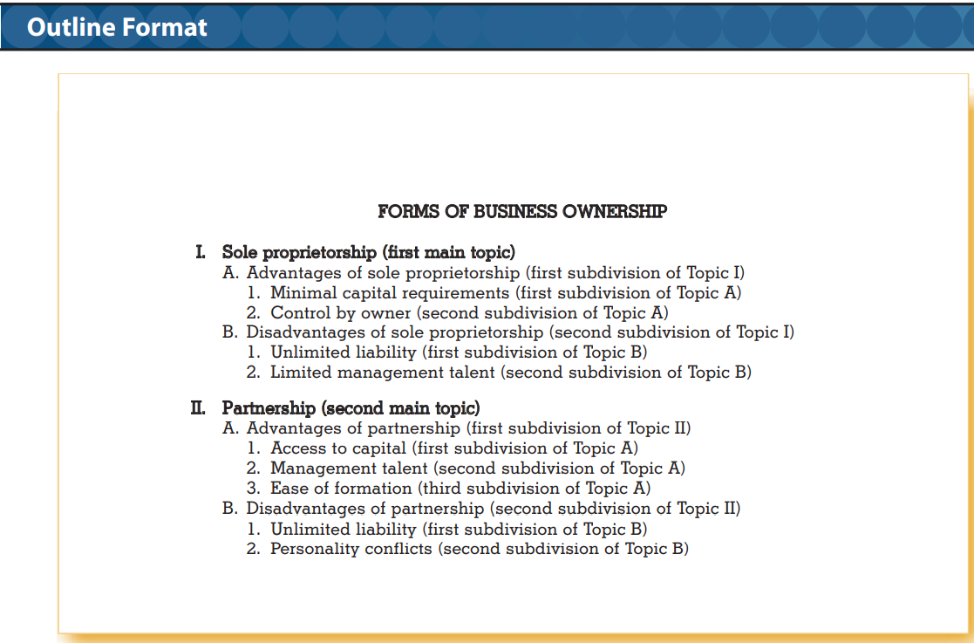
Proposal and Reports

Slide 34
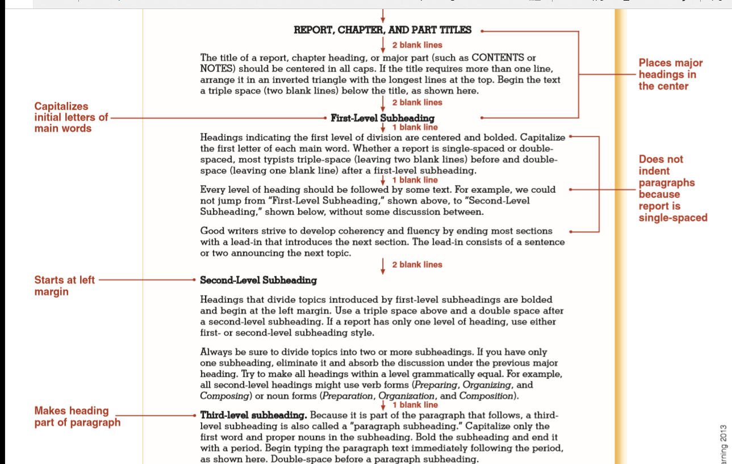

Slide 35
Formal Business Reports Final Report
Long reports are organized into three major divisions:
Front matter
Body
Back matter

Slide 36
Front Matter:
Title page
Letter/memo of transmittal
Table of contents
List of figures
Executive summary

Slide 37
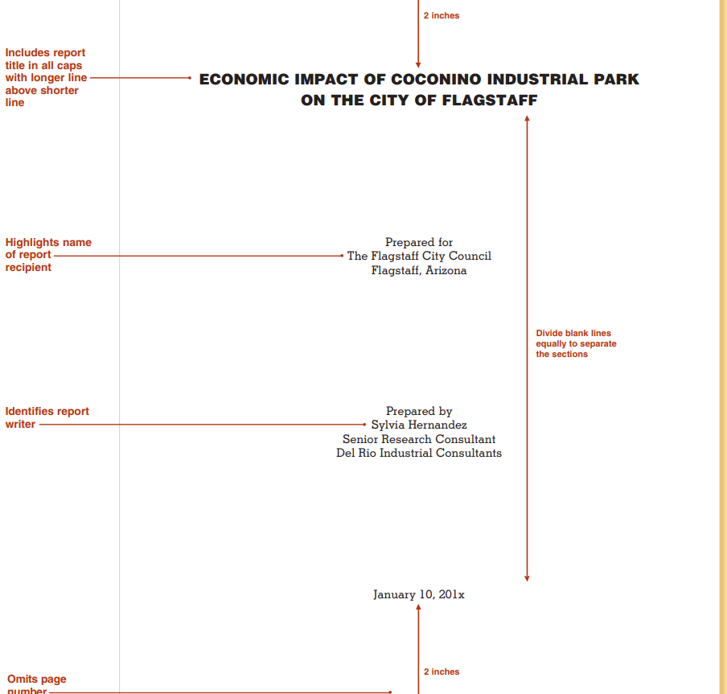
Title Page

Slide 38
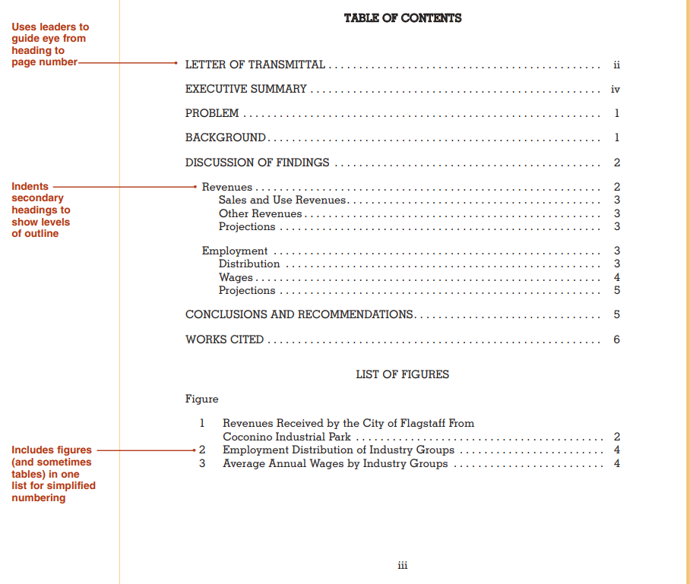
Table of Contents

Slide 39
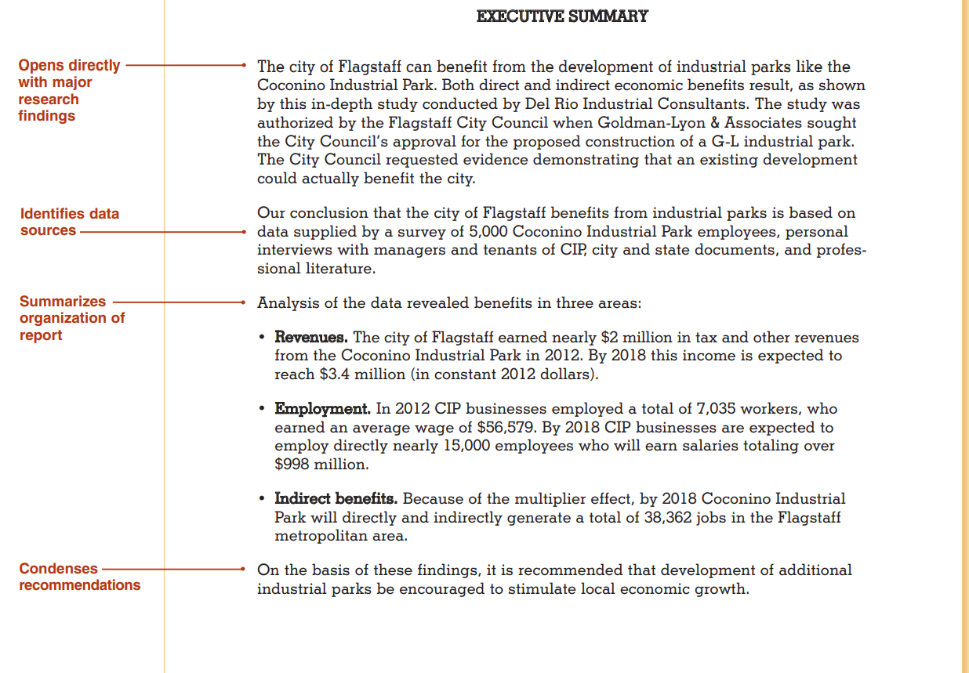
Executive Summary

Slide 40
Formal Business Reports Body of report
Body of report contains the following:
Introduction
Discussion of Findings – main section
Heading and subheadings used to divide into readable sections
Analysis and interpretations
Graphs, tables etc.
Conclusions and Recommendations

Slide 41
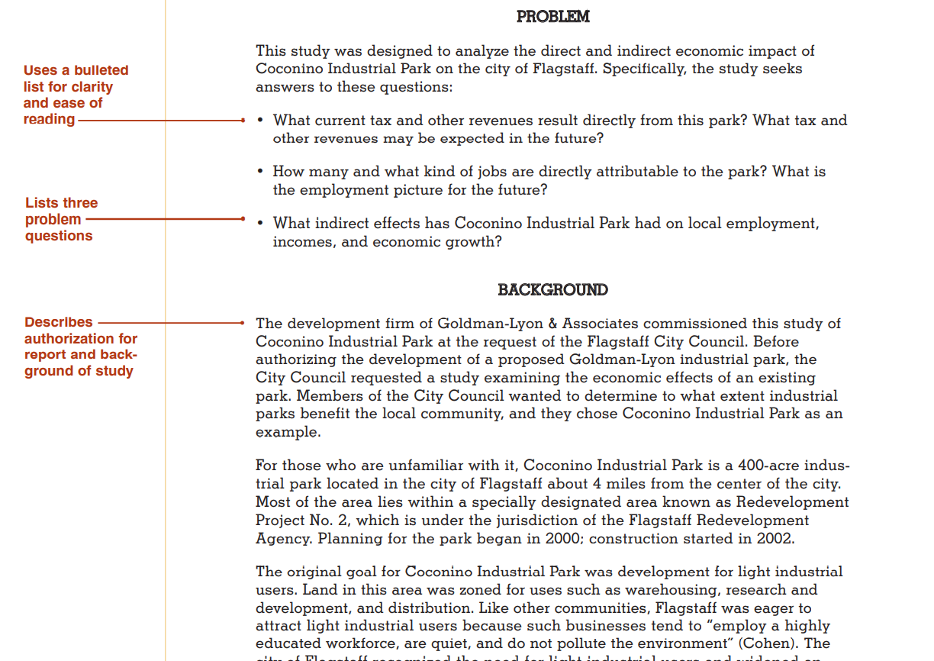
Body of Report – Introduction/Opening

Slide 42
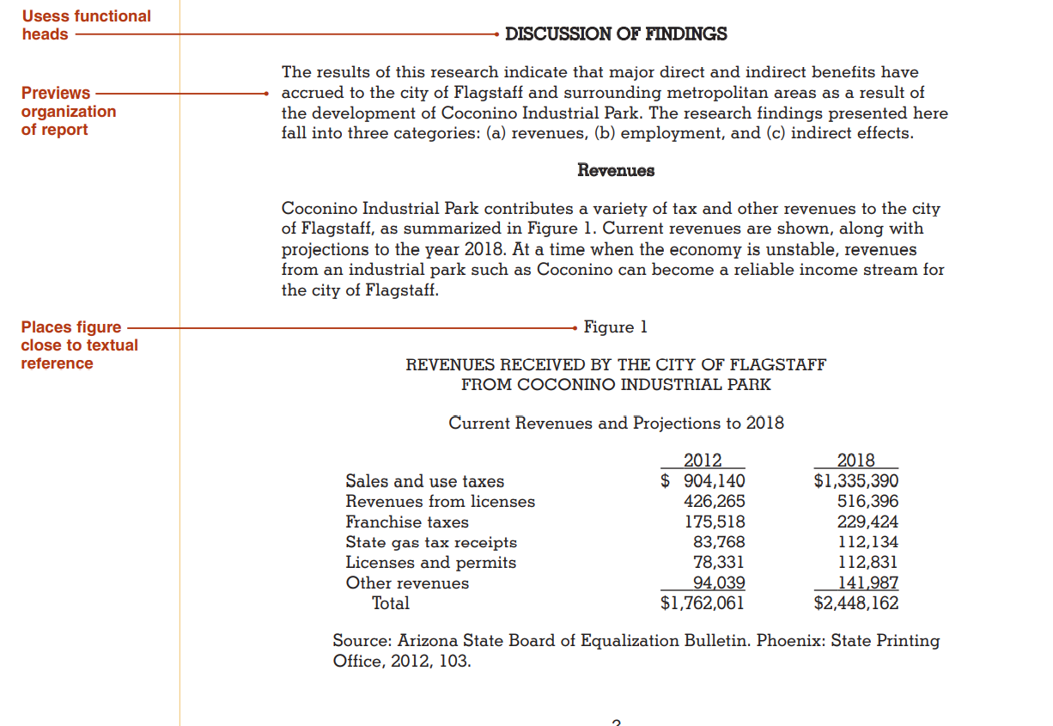
Body: Discussion

Slide 43
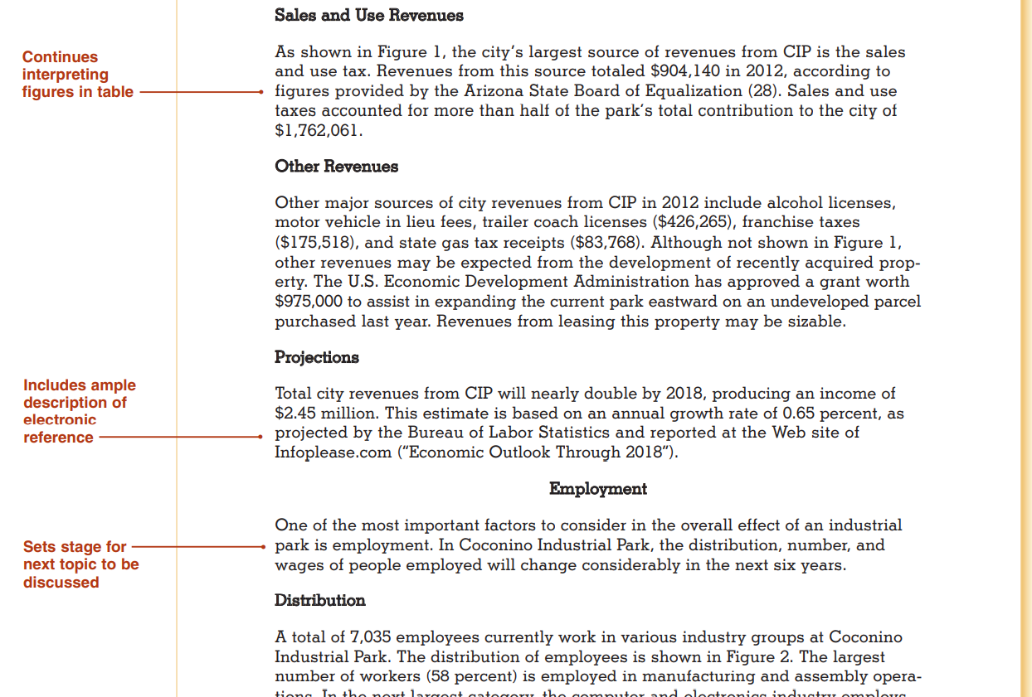
Body: Discussion

Slide 44
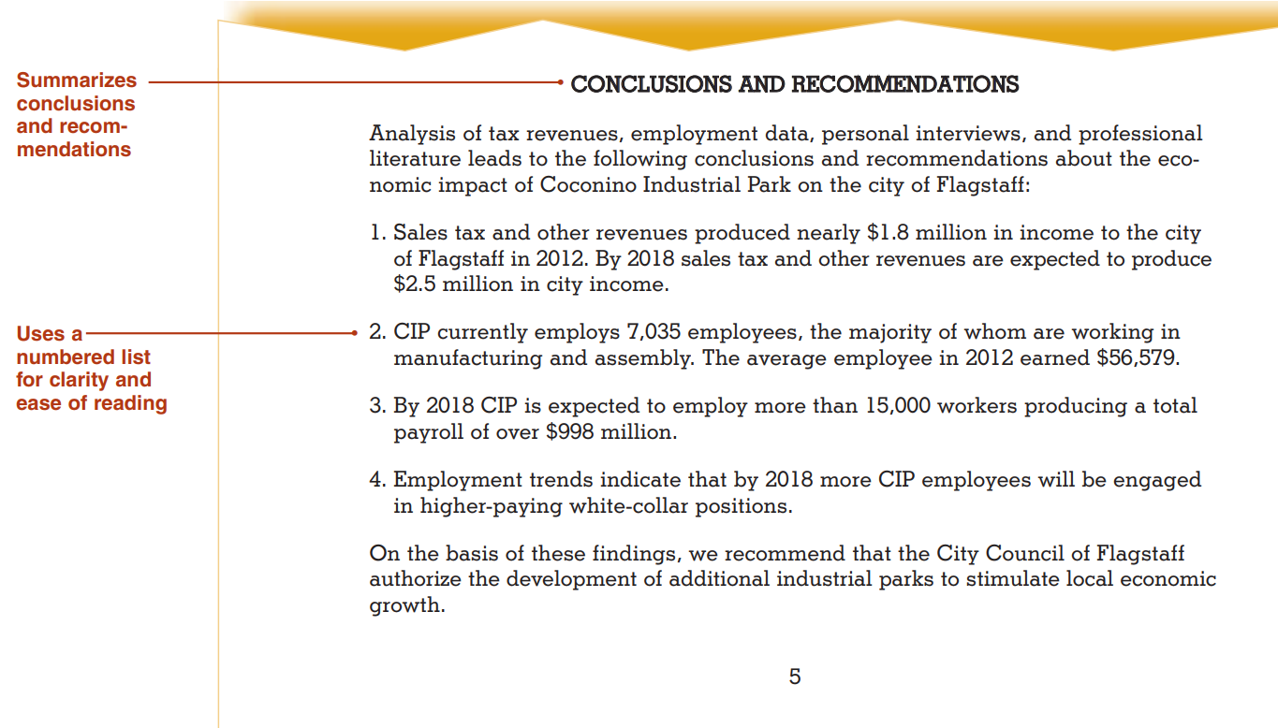
Body: Conclusion

Slide 45
Formal Business Reports Back Matter
Back matter:
Supplementary Parts
Works cited, References, Bibliography
Appendixes

Slide 46
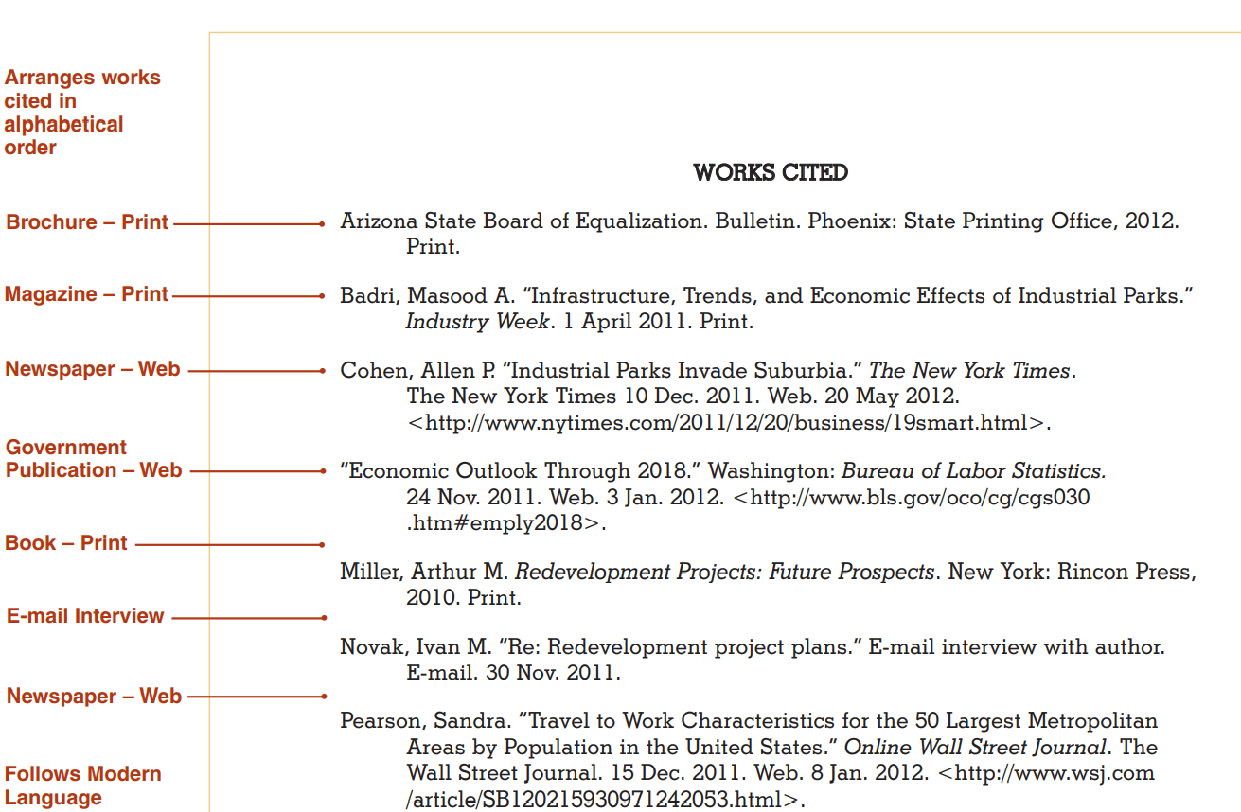
Report: Back Matter

Slide 47
BUSINESS PROPOSALS

Slide 48
Proposals
Proposals are written to solve problems, provide services, or sell products
May be internal or external (90%)
Solicited or unsolicited
Solicited proposals are usually preceded by a Request for Proposal (RFP)
Most proposals use a persuasive strategy

Slide 49
Informal Proposals
Most often in the form of a letter – letter proposal
Six principal components
Introduction
Background
Proposal
Staffing (usually for internal proposals)
Budget (costs)
Authorization request

Slide 50
Informal Proposals
Introduction:
Begin with a brief explanation of reasons for the proposal and highlight writer’s qualifications
Finding a “hook” makes the introduction more persuasive
Extraordinary results
Low costs or fast results
Exclusive resources
Identified problem
Key issues that need resolving or benefits.

Slide 51
Informal Proposals
Background, Problem or Purpose
This section identifies the problem and discusses goals or purpose of the project
With unsolicited proposals, the more detailed your description of the problem, the more persuasive your argument
Monetary losses, failure to comply, regulations,
With solicited proposals, you need to show complete understanding of the problem
Repeating language

Slide 52
Informal Proposals
Proposal, Plan and Schedule: In this section, discuss plans for solving the problem
Paradox: how does one disclose enough of plan without giving away too much information?
Indicate what you propose to do/provide and how it will benefit reader
Identify deliverables
Identify timeline
Staffing: Numbers, credentials and expertise of staff
If possible, tie staff resumes to RFP requirements

Slide 53
Informal Proposals
Budget: a list of proposed project costs
A proposal represents a contract – cannot raise price later
Include deadline for acceptance
Itemize hours and costs if possible, or line-by-line budget
A lump sum budget might be more useful for minor proposals
Authorization request: Closing
Close with a request for approval or authorization
A model contract might be included that responds to requirements specified in the RFP

Slide 54
Formal Proposals
Formal proposals differ from informal proposals not in content, but in size
Large projects
Multibillion dollar contract bids
Usually prepared professionally using a team of experts and organized into multiple parts
Usually contain additional elements
Copy of original RFP
Letter of transmittal
Abstract or executive summary
Title page, table of contents, list of figures and tables, appendix and index
Transmitted either in hardcopy or electronically

Slide 55
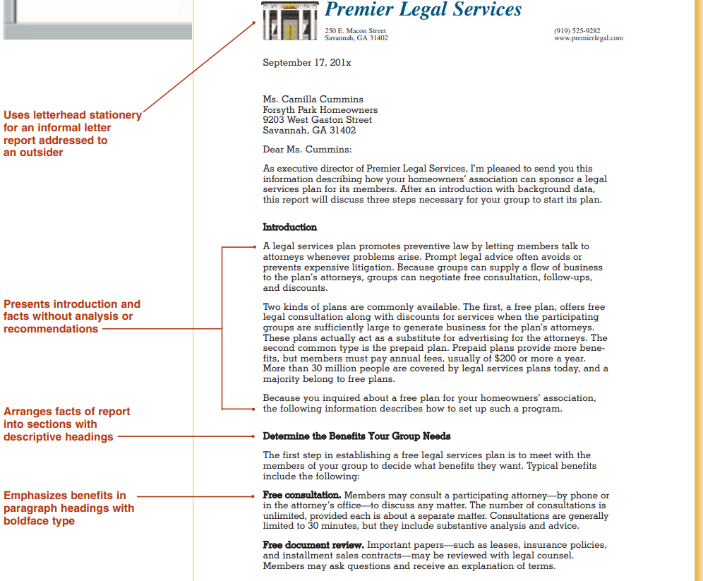

Slide 56
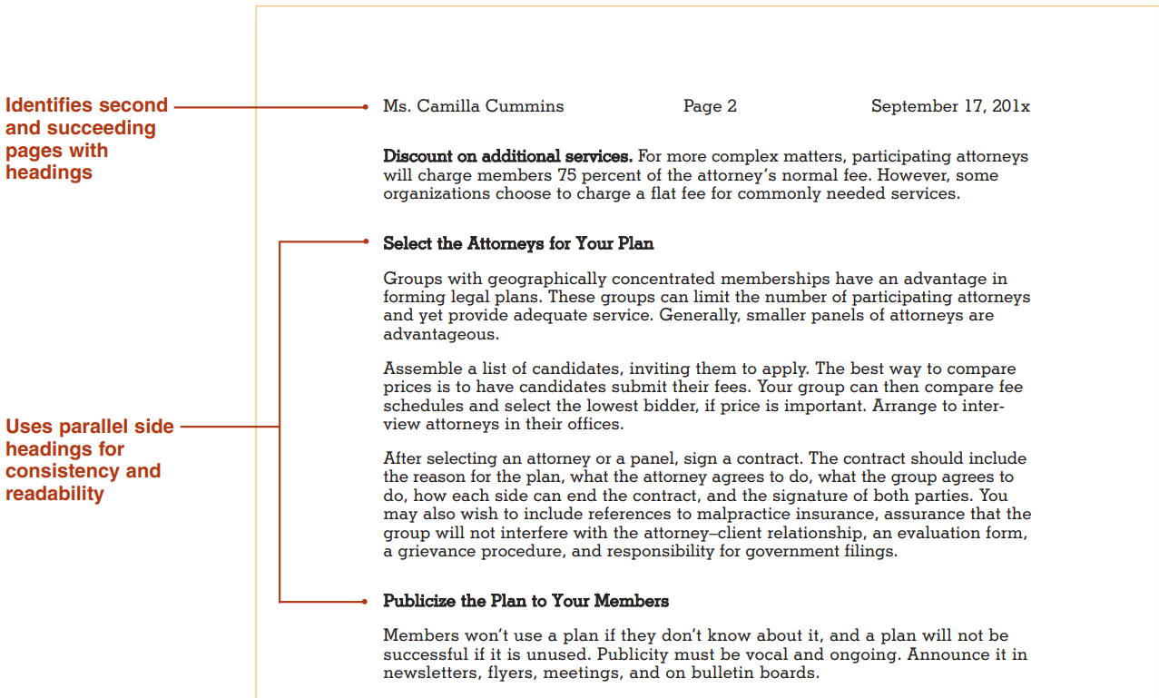
Letter: Additional Pages

Slide 57
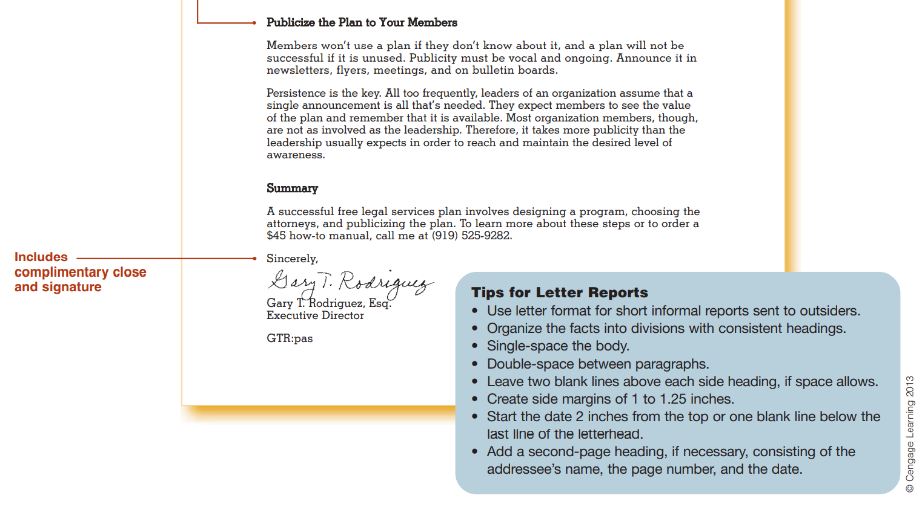
Letters: Concluding

Slide 58
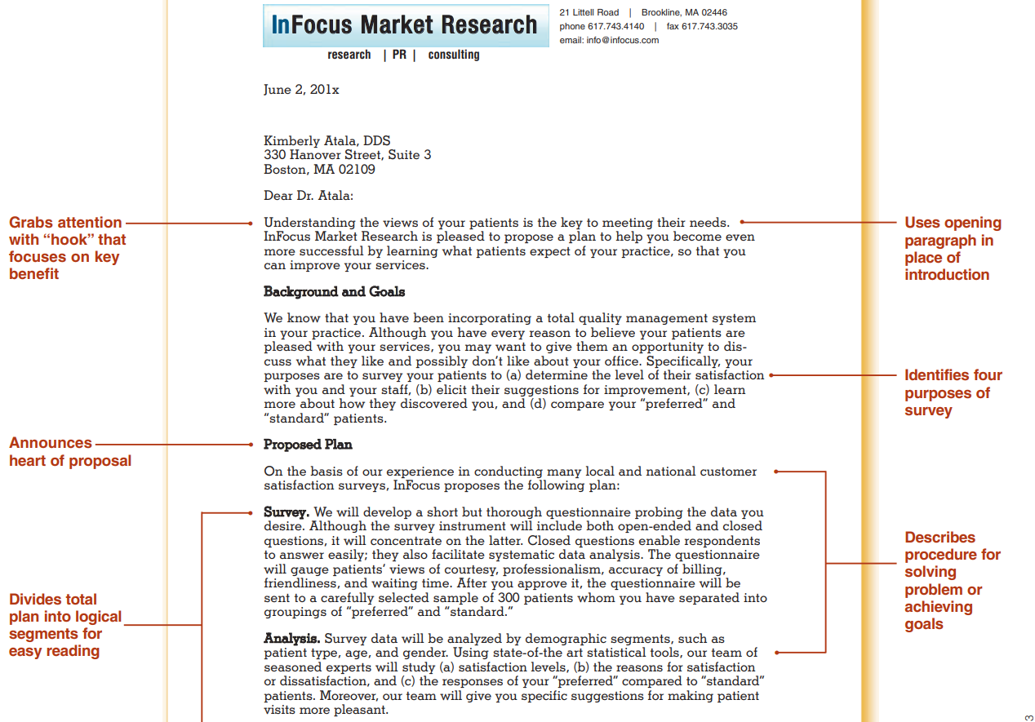
Formal Business Proposals: Unsolicited

